Slide 1
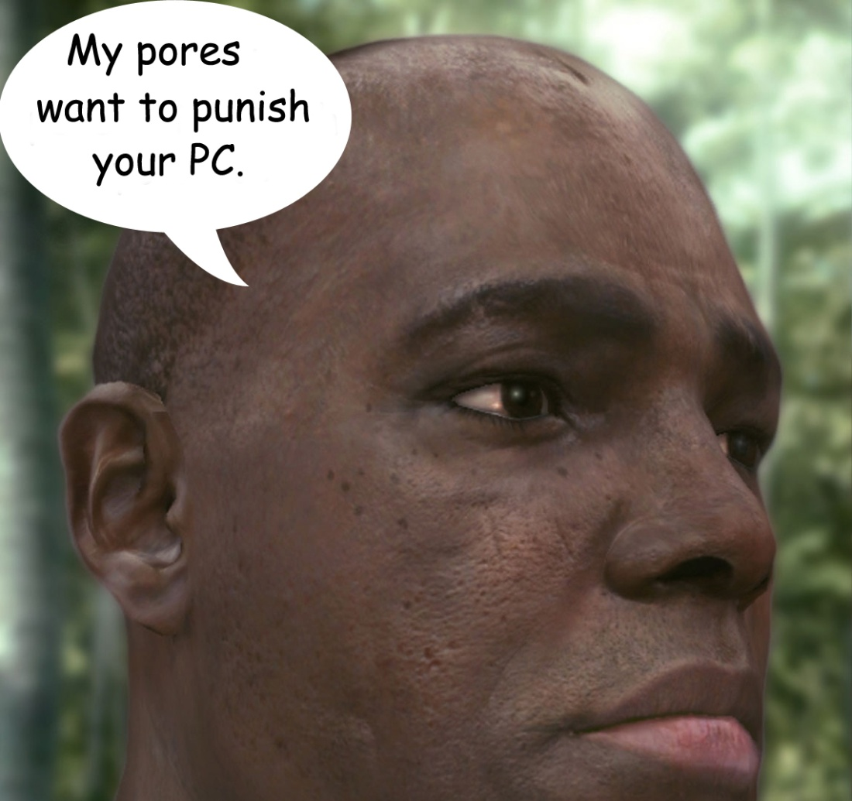
Pixel shaders: Eye Candy and Beyond
Nick Kitten

Slide 2
What I’ll be Talking About
Abstract overview of GPU pipeline
How Pixel Shaders work
Applications
Techniques
Tools available for creation

Slide 3
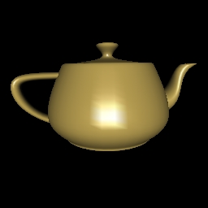
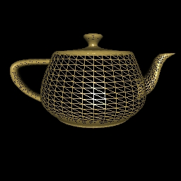
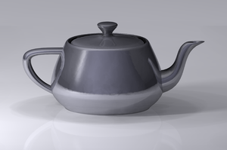
Pipeline Levels of Detail
Models
Vertices
Faces

Slide 4
Vertex/Pixel Shader Comparison
Vertex Shaders
Pixel (Fragment) Shaders
Responsible for View/Projection transformations
Used to apply mesh deformations, some lighting calculations
Responsible for outputting color information
Used for texturing, detailed shading, post-processing
DEMO
INTERPOLATION

Slide 5
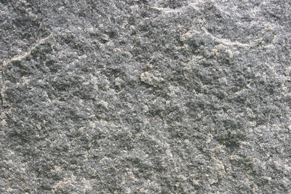
General Pixel Shader Model
Texture Samples
Processing
Colors
Ø
f(x,y,…)
(R,G,B,A)
Constants – Floats, Vectors, Matrices

Slide 6
Higher-Level Units
Shader
Pass
Technique
Effect
V
P
F
T
V
P
F
E
V
P
F
T
V
P
F

Slide 7
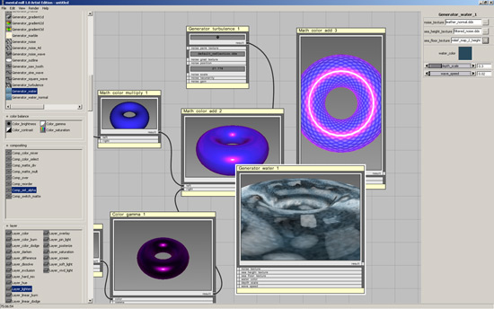
Higher-Level Units: Shader Graph

Slide 8
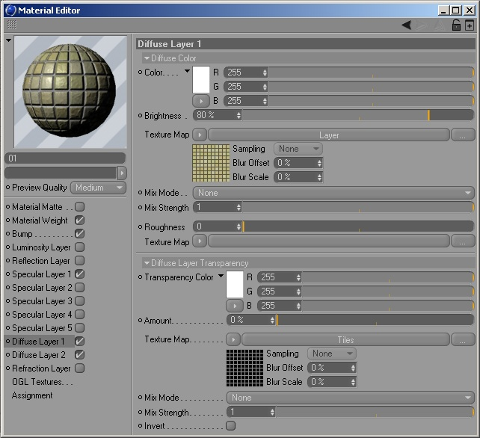
Higher-Level Units: Materials
Materials are instances of effects

Slide 9
General Pixel Shader Model
Texture Samples
Processing
Colors
Ø
f(x,y,…)
(R,G,B,A)
Constants – Floats, Vectors, Matrices

Slide 10
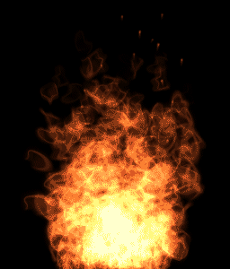
Textureless Shaders
Textures used as input for other passes
Fractals
Animated Noise

Slide 11
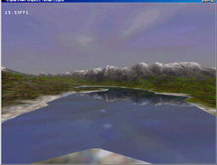
One-Dimensional Textures
Fresnel Reflectance
Save expensive lighting computations
Fog, Water, Heightmaps
Palette mapping
Cell shading

Slide 12
Palette Mapping

Slide 13
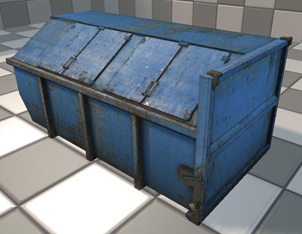
Two-Dimensional Textures
Diffuse, Specular, Bump, Normal, Light Maps

Slide 14
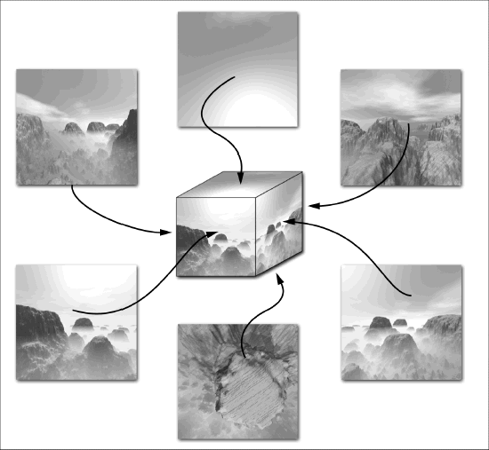
Environment Mapping

Slide 15
Displacement Mapping
Click to Reset

Slide 16
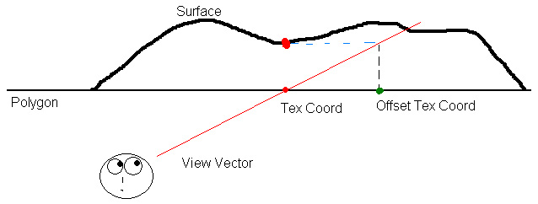
Parallax / Relief Mapping

Slide 17
Stencil Buffer
Low-precision buffer
Allows masking of specific areas
Can be used for arbitrary viewports; mirrors
Press “s” to switch views

Slide 18
Volumetric Textures
3D data
Lookups
Cutaways
Volume rendering

Slide 19
Volumetric Rendering

Slide 20
Tools: Drawing APIs
Direct3D
OpenGL
Windows-specific
Updates come in major, standardized releases
HLSL
Left-hand coordinate system
Uses row vectors (right matrix-multiply)
Cross-platform
Updates come in small, quick extensions
GLSL
Right-hand coordinate system
Uses column vectors (left matrix-multiply)

Slide 21
Tools: Shader Creation
Adobe Pixel Bender
Simple
Works for Photoshop, AfterEffects, and Flash
Will use either DirectX or OpenGL
DEMO
RESULT
ATI RenderMonkey
Nvidia FX Composer

Slide 22
References
Akenine-Moller, Tomas, et al. Real-Time Rendering: Third Edition. A K Peters: Wellesley, MA (2008)
Luna, Frank D. Introduction to 3D Game Programming with DirectX 9.0c: A Shader Approach. Wordware Publishing: Plano, TX (2006)

Slide 23
Images
http://www.everyjoe.com/articles/ea-sets-release-date-for-crysis-81/
http://www.gamedev.net/reference/articles/article1763.asp
http://www.cs.uiowa.edu/~cwyman/classes/spring07-22C251/
http://www.derschmale.com/demo/volumeRendering/ultra-lq-switch.html
http://www.answers.com/topic/utah-teapot
http://www.freeseamlesstextures.com/texture_tutorials/index.htm
http://whatisnotseen.wordpress.com/2008/08/12/the-house-of-modern-finance-the-house-of-cards/
http://www.gamedev.net/reference/art/features/fireParticles/page2.asp
http://en.wikipedia.org/wiki/Fresnel_equations
http://ddg.sourceforge.net/screenshot.html
http://flavors.me/rschu
http://www.gamespot.com/users/wm161406/view_image?id=Oddf5Rok7hqe7RvmnA
http://www.3d-test.com/interviews/mental_2.htm
http://www.vray.com/vray_for_cinema_4d/manual/material_layered_channels.shtml
http://www.chrisalbeluhn.com/UT3_Asset_Creation.html
http://www.ee.qub.ac.uk/graphics/openfx/demo.htm
http://www.developer.com/lang/other/article.php/2169281/Environment-Mapping-Techniques.htm
http://www.pixolator.com/showthread.php?t=79772

Slide 24
Have Any Questions?
Well, do ya…punk?

